Slide 1
CAP-404
Unit - III

Slide 2
SUBSTITUTION TECHNIQUES
A substitution technique is one in which the letters of plaintext are replaced by other letters or by numbers or symbols.
If the plaintext is viewed as a sequence of bits, then substitution involves replacing plaintext bit patterns with ciphertext bit patterns.
Substitution technique is a classical encryption technique where the characters present in the original message are replaced by the other characters or numbers or by symbols.

Slide 3
Continue..
If the plain text (original message) is considered as the string of bits, then the substitution technique would replace bit pattern of plain text with the bit pattern of ciphertext.

Slide 4
Caesar Cipher
This is the simplest substitution cipher by Julius Caesar. In this substitution technique, to encrypt the plain text, each alphabet of the plain text is replaced by the alphabet three places further it. And to decrypt the ciphertext each alphabet of ciphertext is replaced by the alphabet three places before it.
Let us take a simple example:
Plain Text: meet me tomorrow

Slide 5
Continue..
Cipher Text: phhw ph wrpruurz
Look at the example above, we have replaced, ‘m’ with ‘p’ which occurs three places after, ‘m’. Similarly, ‘e’ is replaced with ‘h’ which occurs in three places after ‘e’.
Note: If we have to replace the letter ‘z’ then the next three alphabets counted after ‘z’ will be ‘a’ ‘b’ ‘c’. So, while counting further three alphabets if ‘z’ occurs it circularly follows ‘a’.

Slide 6
Question
Use Caesar’s Cipher to decipher the following
HQFUBSWHG WHAW
a) ABANDONED LOCK
b) ENCRYPTED TEXT
c) ABANDONED TEXT
d) ENCRYPTED LOCK

Slide 7
Drawback
There are also some drawbacks of this simple substitution technique.
If the hacker knows that the Caesar cipher is used then to perform brute force cryptanalysis, he has only to try 25 possible keys to decrypt the plain text.
The hacker is also aware of the encryption and decryption algorithm.

Slide 8
Continue..
There is, however, another line of attack. If the cryptanalyst knows the nature of the plaintext (e.g., non-compressed English text), then the analyst can exploit the regularities of the language.
With only 25 possible keys, the Caesar cipher is far from secure. A dramatic increase in the keyspace can be achieved by allowing an arbitrary substitution.

Slide 9
Example:
plain: a b c d e f g h i j k l m n o p q r s t u v w x y z
cipher: D E F G H I J K L M N O P Q R S T U V W X Y Z A B C

Slide 10
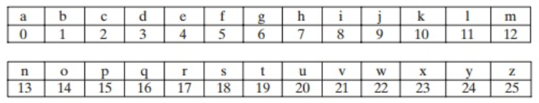
Key Generation
If it is known that a given ciphertext is a Caesar cipher, then brute-force cryptanalysis is easily performed: simply try all the 25 possible keys.
Figure shows the results of applying this strategy to the example ciphertext. In this case, the plaintext leaps out as occupying the third line.

Slide 11
Continue..
Three important characteristics of this problem enabled us to use brute-force cryptanalysis:
1. The encryption and decryption algorithms are known.
2. There are only 25 keys to try.
3. The language of the plaintext is known and easily recognizable.

Slide 12
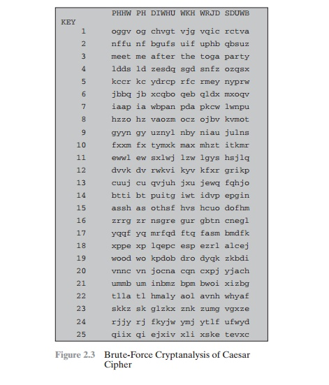
Brute Force Cryptanalysis for Caesar Cipher

Slide 13
Question
Caesar Cipher is an example of
a) Poly-alphabetic Cipher
b) Mono-alphabetic Cipher
c) Multi-alphabetic Cipher
d) Bi-alphabetic Cipher

Slide 14
Monoalphabetic Cipher
Monoalphabetic cipher is a substitution cipher, where the cipher alphabet for each plain text alphabet is fixed, for the entire encryption.
In simple words, if the alphabet ‘p’ in the plain text is replaced by the cipher alphabet ‘d’. Then in the entire plain text wherever alphabet ‘p’ is used, it will be replaced by the alphabet ‘d’ to form the ciphertext.

Slide 15
Vulnerabilities
Monoalphabetic ciphers are easy to break because they reflect the frequency data of the original alphabet.
A countermeasure is to provide multiple substitutes, known as homophones, for a single letter.
For example, the letter e could be assigned a number of different cipher symbols, such as 16, 74, 35, and 21, with each homophone assigned to a letter in rotation or randomly.
If the number of symbols assigned to each letter is proportional to the relative frequency of that letter, then single-letter frequency information is completely obliterated.

Slide 16
Continue..
The great mathematician Carl Friedrich Gauss believed that he had devised an unbreakable cipher using homo-phones.
However, even with homophones, each element of plaintext affects only one element of ciphertext, and multiple-letter patterns (e.g., digram frequencies) still survive in the ciphertext, making cryptanalysis relatively straightforward.

Slide 17
playfair cipher
The best known multiple letter encryption cipher is the playfair, which treats digrams in the plaintext as single units and translates these units into cipher text digrams.
The playfair algorithm is based on the use of 5x5 matrix of letters constructed using a keyword.
Let the keyword be „monarchy‟. The matrix is constructed by filling in the letters of the keyword (minus duplicates) from left to right and from top to bottom, and then filling in the remainder of the matrix with the remaining letters in alphabetical order.

Slide 18
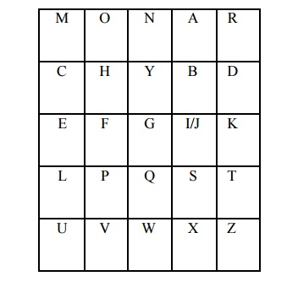
Continue..

Slide 19
Rules:
The letter „i‟ and „j‟ count as one letter. Plaintext is encrypted two letters at a time according to the following rules:
Repeating plaintext letters that would fall in the same pair are separated with a filler letter such as „x‟.
Plaintext letters that fall in the same row of the matrix are each replaced by the letter to the right, with the first element of the row following the last.

Slide 20
Continue..
Plaintext letters that fall in the same column are replaced by the letter beneath, with the top element of the column following the last.
Otherwise, each plaintext letter is replaced by the letter that lies in its own row and the column occupied by the other plaintext letter.

Slide 21
Example
Plain Text: meet me tomorrow
Key: KEYWORD
Now, we have to convert this plain text to ciphertext using the given key. We will discuss the further process in steps.

Slide 22
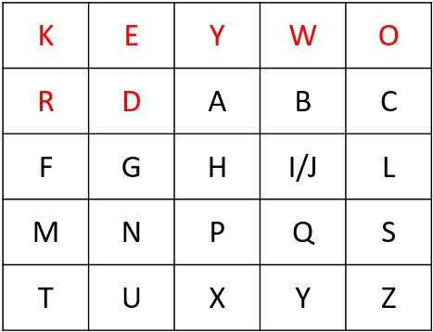
Continue..

Slide 23
Step 1:
Create a 5X5 matrix and place the key in that matrix row-wise from left to right. Then put the remaining alphabets in the blank space.
Note: If a key has duplicate alphabets, then fill those alphabets only once in the matrix, and I & J should be kept together in the matrix even though they occur in the given key.

Slide 24
Step 2:
Now, you have to break the plain text into a pair of alphabets.
Plain Text: meet me tomorrow
Pair: me et me to mo rx ro wz

Slide 25
Note
Pair of alphabets must not contain the same letter. In case, pair has the same letter then break it and add ‘x’ to the previous letter. Like in our example letter ‘rr’ occurs in pair so, we have broken that pair and added ‘x’ to the first ‘r’.
In case while making pair, the last pair has only one alphabet left then we add ‘z’ to that alphabet to form a pair as in our above example, we have added ‘z’ to ‘w’ because ‘w’ was left alone at last.
If a pair has ‘xx’ then we break it and add ‘z’ to the first ‘x’, i.e. ‘xz’ and ‘x_’.

Slide 26
Step 3:
In this step, we will convert plain text into ciphertext. For that, take the first pair of plain text and check for cipher alphabets for the corresponding in the matrix. To find cipher alphabets follow the rules below.

Slide 27
Note
If both the alphabets of the pair occur in the same row replace them with the alphabet to their immediate right. If an alphabet of the pair occurs at extreme right then replace it with the first element of that row, i.e. the last element of the row in the matrix circularly follows the first element of the same row.
If the alphabets in the pair occur in the same column, then replace them with the alphabet immediate below them. Here also, the last element of the column circularly follows the first element of the same column.

Slide 28
Continue..
If the alphabets in the pair are neither in the same column and nor in the same row, then the alphabet is replaced by the element in its own row and the corresponding column of the other alphabet of the pair.

Slide 29
Example:
Pair: me et me to mo rx ro wz
Cipher Text: kn ku kn kz ks ta kc yo
So, this is how we can convert a plain text to ciphertext using Playfair cipher. When compared with monoalphabetic cipher Playfair cipher is much more advanced. But still, it is easy to break.

Slide 30
Hill cipher
Another interesting multiletter cipher is the Hill cipher, developed by the mathe-matician Lester Hill in 1929.
Plain text: Binary
Key: HILL
Choose the key in such a way that it always forms a square matrix. With HILL as the key, we can form a 2×2 matrix.

Slide 31
Continue..
Now, of plain text, you have to form a column vector of length similar to the key matrix. In our case, the key matrix is 2×2 then the column vectors of plain text would be 2×1.

Slide 32
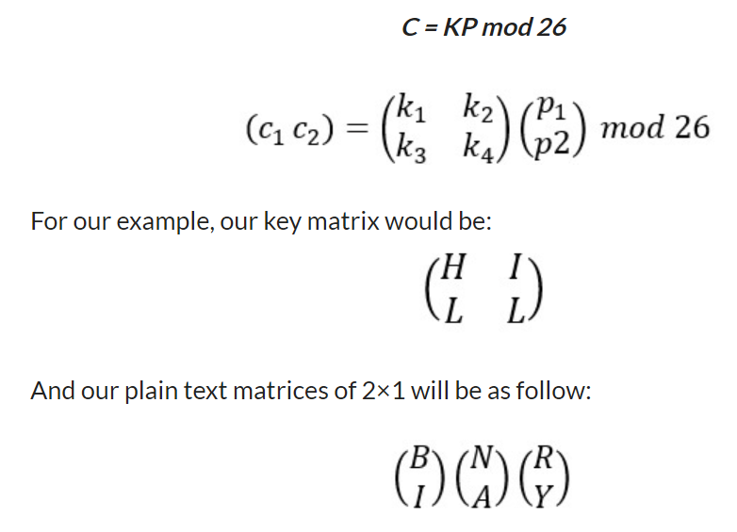
The general equation

Slide 33
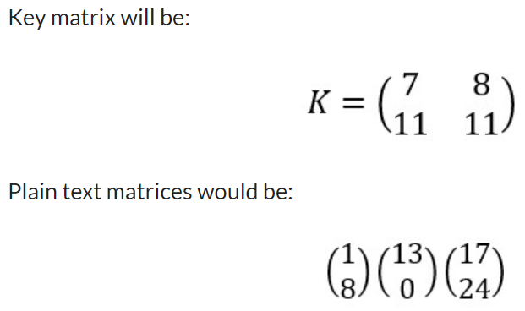
Continue..
Now, we have to convert the key matrix and plain text matrices into numeric matrices. For that number the alphabets such as A=0, B=1, C=2, …………, Z=25. So, considering the alphabet numbering:

Slide 34
In the first calculation, we would get two cipher alphabets for plain text alphabet ‘B’ & ‘I’

Slide 35
Continue..
So, the cipher alphabet for plain text alphabet ‘B’ & ‘I’ is ‘T’ & ‘V’. Similarly, we have to calculate ciphertext for the remaining plain text. And then accumulate them to form the ciphertext.
The calculated ciphertext for ‘Binary’ using hill cipher is ‘TVNNZJ’.

Slide 36
Question
Hill cipher requires prerequisite knowledge of?
a) integration
b) differentiation
c) matrix algebra
d) differential equation

Slide 37
Question
Hill cipher is an example of ____________
a) mono-alphabetic cipher
b) substitution cipher
c) transposition cipher
d) additive cipher

Slide 38
Question
Encryption in hill cipher is done using ______________
a) matrix multiplication
b) a 5×5 table
c) vigenere table
d) matrix inversion

Slide 39
Question
What will be the size of a key matrix if the plain text is “SECRET”?
a) 1×6
b) 5×1
c) 6×1
d) 6×6

Slide 40
Homophonic Substitution Cipher
The Homophonic Substitution cipher is a substitution cipher in which single plaintext letters can be replaced by any of several different ciphertext letters. They are generally much more difficult to break than standard substitution ciphers.
The number of characters each letter is replaced by is part of the key, e.g. the letter 'E' might be replaced by any of 5 different symbols, while the letter 'Q' may only be substituted by 1 symbol.

Slide 41
Continue..
The easiest way to break standard substitution ciphers is to look at the letter frequencies, the letter 'E' is usually the most common letter in english, so the most common ciphertext letter will probably be 'E' (or perhaps 'T’).
If we allow the letter 'E' to be replaced by any of 3 different characters, then we can no longer just take the most common letter, since the letter count of 'E' is spread over several characters. As we allow more and more possible alternatives for each letter, the resulting cipher can become very secure.

Slide 42
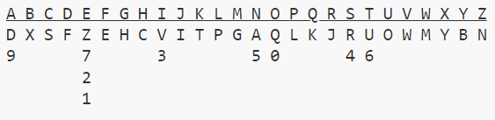
Example
Cipher Alphabate

Slide 43
Continue..
To encipher the message DEFEND THE EAST WALL OF THE CASTLE, we find 'D' in the top row, then replace it with the letter below it, 'F'. The second letter, 'E' provides us with several choices, we could use any of 'Z', '7', '2' or '1'. We choose one of these at random, say '7'. After continuing with this, we get the ciphertext:
plaintext: DEFEND THE EAST WALL OF THE CASTLE
ciphertext: F7EZ5F UC2 1DR6 M9PP 0E 6CZ SD4UP1

Slide 44
Continue..
The number of ciphertext letters assigned to each plaintext letter was chosen to flatten the frequency distribution as much as possible. Since 'E' is normally the most common letter, it is allowed more possibilities so that the frequency peak from the letter 'E' will not be present in the ciphertext.

Slide 45
Cryptanalysis
Breaking homophonic substitution ciphers can be very difficult if the number of homophones is high.
The usual method is some sort of hill climbing, similar to that used in breaking substitution ciphers.
In addition to finding which letters map to which others, we also need to determine how many letters each plaintext letter can become.

Slide 46
Continue..
This is handled in this attempt by having 2 layers of nested hill climbing: an outer layer to determine the number of symbols each letter maps to, then an inner layer to determine the exact mapping.

Slide 47
Question
What is the meaning of cipher in cryptography?
a) an algorithm that performs encryption
b) an algorithm that generates a secret code
c) an algorithm that performs encryption or decryption
d) a secret code

Slide 48
polygram substitution cipher
Monoalphabetic substitution ciphers -- ones which were encoded using only one fixed alphabet (hence the Greek root "mono" meaning "one").
As you saw, especially when the spaces between words are still there, these are fairly easy to break. Given a few minutes and several people working on a message, the secret contents are revealed.
So, how can you make this harder? Well, one way is to use more than one alphabet, switching between them systematically.

Slide 49
Continue..
This type of cipher is called a polyalphabetic substitution cipher ("poly" is the Greek root for "many"). The difference, as you will see, is that frequency analysis no longer works the same way to break these.
One such cipher is the famous Vigenere cipher, which was thought to be unbreakable for almost 300 years! The Vigenere cipher uses the power of 26 possible shift ciphers (which we met last week).

Slide 50
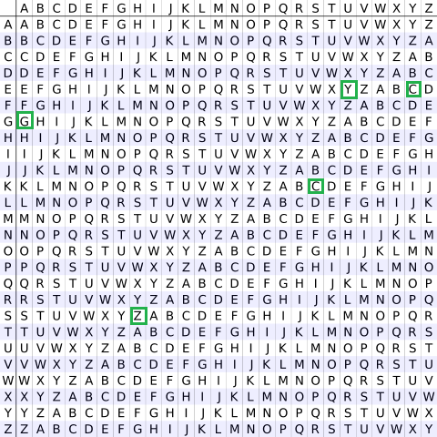
Continue..

Slide 51
Question
Which of the following ciphers are created by shuffling the letters of a word?
a) substitution cipher
b) transposition cipher
c) vigenere cipher
d) hill cipher

Slide 52
2 TRANSPOSITION TECHNIQUES
All the techniques examined so far involve the substitution of a cipher text symbol for a plaintext symbol. A very different kind of mapping is achieved by performing some sort of permutation on the plaintext letters. This technique is referred to as a transposition cipher.

Slide 53
Rail fence
Rail fence is simplest of such cipher, in which the plaintext is written down as a sequence of diagonals and then read off as a sequence of rows.
Plaintext = meet at the school house
To encipher this message with a rail fence of depth 2, we write the message as follows:
m e a t e c o l o s
e t t h s H o h u e
The encrypted message is:
MEATECOLOSETTHSHOHUE

Slide 54
Question
Which of the following is a type of transposition cipher?
a) Rail Fence cipher
b) Hill cipher
c) Rotor cipher
d) One time pad

Slide 55
Encryption
In a transposition cipher, the order of the alphabets is re-arranged to obtain the cipher-text.
In the rail fence cipher, the plain-text is written downwards and diagonally on successive rails of an imaginary fence.
When we reach the bottom rail, we traverse upwards moving diagonally, after reaching the top rail, the direction is changed again. Thus the alphabets of the message are written in a zig-zag manner.
After each alphabet has been written, the individual rows are combined to obtain the cipher-text.

Slide 56
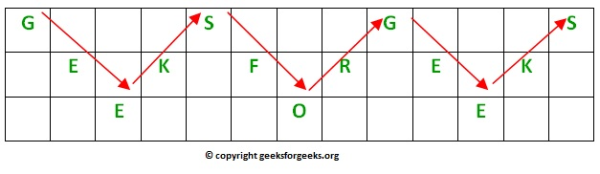
Example
For example, if the message is “GeeksforGeeks” and the number of rails = 3 then cipher is prepared as:

Slide 57
Decryption
As we’ve seen earlier, the number of columns in rail fence cipher remains equal to the length of plain-text message. And the key corresponds to the number of rails.
Hence, rail matrix can be constructed accordingly. Once we’ve got the matrix we can figure-out the spots where texts should be placed (using the same way of moving diagonally up and down alternatively ).
Then, we fill the cipher-text row wise. After filling it, we traverse the matrix in zig-zag manner to obtain the original text.

Slide 58
Implementation:
Let cipher-text = “GsGsekfrek eoe” , and Key = 3
Number of columns in matrix = len(cipher-text) = 13
Number of rows = key = 3
Hence original matrix will be of 3*13 .

Slide 59
Example 1
Encryption
Input : "GeeksforGeeks "
Key = 3
Output : GsGsekfrek eoe
Decryption
Input : GsGsekfrek eoe
Key = 3
Output : "GeeksforGeeks "

Slide 60
Example 2
Encryption
Input : "defend the east wall"
Key = 3
Output : dnhaweedtees alf tl
Decryption
Input : dnhaweedtees alf tl
Key = 3
Output : defend the east wall

Slide 61
Example 3
Encryption
Input : "attack at once"
Key = 2
Output : atc toctaka ne
Decryption
Input : "atc toctaka ne"
Key = 2
Output : attack at once

Slide 62
Question
Which of the following ciphered text would have used transposition cipher for encryption of the plain text “SANFOUNDRY”?
a) SSCMBNUMERY
b) TBMGPVOESZ
c) UCNHQWPFTA
d) SNONRAFUDY

Slide 63
Row Transposition Ciphers
Row Transposition Ciphers-A more complex scheme is to write the message in a rectangle, row by row, and read the message off, column by column, but permute the order of the columns. The order of columns then becomes the key of the algorithm.
e.g., plaintext = meet at the school house

Slide 64
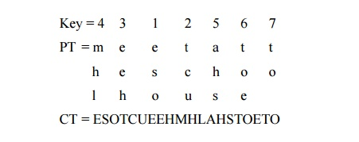
Continue..

Slide 65
Continue..
A pure transposition cipher is easily recognized because it has the same letter frequencies as the original plaintext. The transposition cipher can be made significantly more secure by performing more than one stage of transposition. The result is more complex permutation that is not easily reconstructed.

Slide 66
Columnar Transposition Cipher
Given a plain-text message and a numeric key, cipher/de-cipher the given text using Columnar Transposition Cipher
The Columnar Transposition Cipher is a form of transposition cipher just like Rail Fence Cipher. Columnar Transposition involves writing the plaintext out in rows, and then reading the ciphertext off in columns one by one.

Slide 67
Encryption
In a transposition cipher, the order of the alphabets is re-arranged to obtain the cipher-text.
The message is written out in rows of a fixed length, and then read out again column by column, and the columns are chosen in some scrambled order.
Width of the rows and the permutation of the columns are usually defined by a keyword.

Slide 68
Continue..
For example, the word HACK is of length 4 (so the rows are of length 4), and the permutation is defined by the alphabetical order of the letters in the keyword. In this case, the order would be “3 1 2 4”.
Any spare spaces are filled with nulls or left blank or placed by a character (Example: _).
Finally, the message is read off in columns, in the order specified by the keyword.

Slide 69
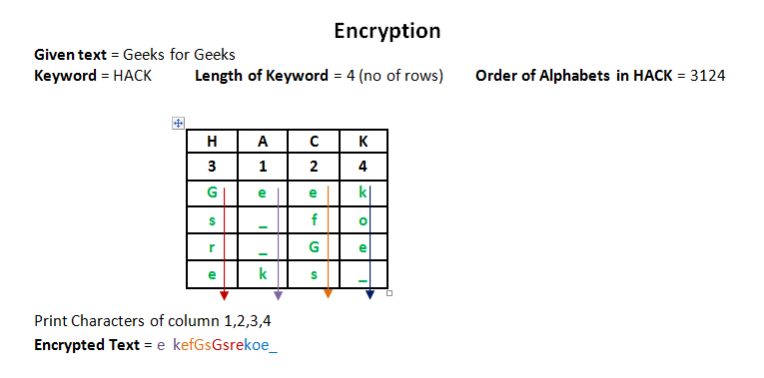
Continue..

Slide 70
Decryption
To decipher it, the recipient has to work out the column lengths by dividing the message length by the key length.
Then, write the message out in columns again, then re-order the columns by reforming the key word.

Slide 71
Question
Which of the following is not a type of traditional cipher?
a) Substitution cipher
b) Transposition cipher
c) Mono alphabetic cipher
d) PKCS cipher

Slide 72
Question
Columnar cipher falls under the category of?
a) mono-alphabetic cipher
b) poly-alphabetic cipher
c) transposition cipher
d) additive cipher

Slide 73
Vernam Cipher in Cryptography
Vernam Cipher is a method of encrypting alphabetic text. It is one of the Transposition techniques for converting a plain text into a cipher text. In this mechanism we assign a number to each character of the Plain-Text, like (a = 0, b = 1, c = 2, … z = 25).
Method to take key:
In Vernam cipher algorithm, we take a key to encrypt the plain text which length should be equal to the length of the plain text.

Slide 74
Encryption Algorithm:
Assign a number to each character of the plain-text and the key according to alphabetical order.
Add both the number (Corresponding plain-text character number and Key character number).
Subtract the number from 26 if the added number is greater than 26, if it isn’t then leave it.

Slide 75
Example:
Plain-Text: RAMSWARUPK
Key: RANCHOBABA
Now according to our encryption algorithm we assign a number to each character of our plain-text and key.
PT: R A M S W A R U P K
NO: 17 0 12 18 22 0 17 20 15 10
KEY: R A N C H O B A B A
NO: 17 0 13 2 7 14 1 0 1 0

Slide 76
Continue..
Now add the number of Plain-Text and Key and after doing the addition and subtraction operation (if required), we will get the corresponding Cipher-Text character number.
CT-NO: 34 0 25 20 29 14 18 20 16 10

Slide 77
Continue..
In this case, there are two numbers which are greater than the 26 so we have to subtract 26 from them and after applying the subtraction operation the new Cipher text character numbers are as follow:
CT-NO: 8 0 25 20 3 14 18 20 16 10
New Cipher-Text is after getting the corresponding character from the number.
CIPHER-TEXT: I A Z U D O S U Q K

Slide 78
Question
Which of the following cipher is formed by applying columnar transposition cipher twice?
a) Rail Fence cipher
b) Route cipher
c) Double transposition cipher
d) One time pad

Slide 79
Book Cipher
The King James Bible, a highly available publication suitable for the book cipher.
A book cipher, or Ottendorf cipher, is a cipher in which the key is some aspect of a book or other piece of text.
Books, being common and widely available in modern times, are more convenient for this use than objects made specifically for cryptographic purposes.
It is typically essential that both correspondents not only have the same book, but the same edition.

Slide 80
Continue..
Traditionally book ciphers work by replacing words in the plaintext of a message with the location of words from the book being used. In this mode, book ciphers are more properly called codes.
This can have problems; if a word appears in the plaintext but not in the book, it cannot be encoded.
An alternative approach which gets around this problem is to replace individual letters rather than words.

Slide 81
Continue..
One such method, used in the second Beale cipher, replaces the first letter of a word in the book with that word's position.
In this case, the book cipher is properly a cipher — specifically, a homophonic substitution cipher. However, if used often, this technique has the side effect of creating a larger ciphertext (typically 4 to 6 digits being required to encipher each letter or syllable) and increases the time and effort required to decode the message.

Slide 82
Choosing the key
The main strength of a book cipher is the key. The sender and receiver of encoded messages can agree to use any book or other publication available to both of them as the key to their cipher.
Someone intercepting the message and attempting to decode it, unless they are a skilled cryptographer, must somehow identify the key from a huge number of possibilities available.

Slide 83
Continue..
In the context of espionage, a book cipher has a considerable advantage for a spy in enemy territory.
A conventional codebook, if discovered by the local authorities, instantly incriminates the holder as a spy and gives the authorities the chance of deciphering the code and sending false messages impersonating the agent.
On the other hand, a book, if chosen carefully to fit with the spy's cover story, would seem entirely innocuous.

Slide 84
Question..
What will be the encrypted text corresponding to plain text “SANFOUNDRY” using columnar transposition cipher with the keyword as “GAMES”?
a) SNONRAFUDY
b) SORAFUDYNN
c) SNAUDNORFY
d) ANFRSUNDOY

Slide 85
What is a Book Cipher?
In a book cipher, a message is translated into numbers using a specific book, dictionary or other text.
The numbering system can vary, but typically it is based on page numbers, line numbers, word numbers or character numbers.
The plaintext is translated letter by letter, or word by word, into numbers that represent each letter or word.
The book or text therefore acts as an encryption key. It is required that both the sender and the receiver of a message use exactly the same book or text as key.

Slide 86
For example, let's use the Verse of the Rings (from Lord of the rings) as our key:
Three Rings for the Elven-kings under the sky,
Seven for the Dwarf-lords in their halls of stone,
Nine for Mortal Men doomed to die,
One for the Dark Lord on his dark throne,
In the Land of Mordor where the Shadows lie,
One ring to rule them all, one ring to find them,
One ring to bring them all and in the darkness bind them
In the Land of Mordor where the Shadows lie.

Slide 87
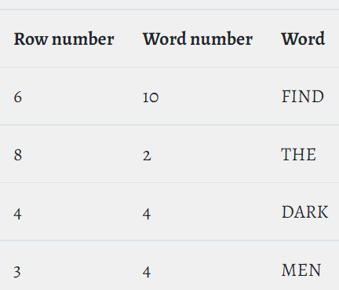
Continue..
Let's say our translation uses row numbers and word numbers. Then this book code: 6:10 8:2 4:4 3:4 would be translated as:

Slide 88
Alternatively, instead of whole words, the book cipher could use just the first letter of each word. The example code would then translate to FTDM. The advantage of translating letter by letter is that you can encode many more different words.
A book cipher is an example of a homophonic substitution cipher, since the same word or letter can be encoded in different ways.

Slide 89
For example, the word THE could have been translated into 1:4, 2:3 or any of the other places where it has been used.
There is no need in a book cipher to keep using the same location for a word or letter. On the contrary, it is more secure to encode it in different ways.

Slide 90
Ottendorf cipher
An Ottendorf cipher is a book cipher consisting of three parts. Usually in one of these formats:
page number - word number - letter number
line number - word number - letter number
The Ottendorf cipher is presumably named after Major Nicholas Dietrich, Baron de Ottendorf who worked for the British, organising spies in the French and American camps.

Slide 91
Choosing a Book
The most important things when using a book cipher is the choice of book.
The sender and receiver have to agree beforehand on exactly which book to use, even which exact edition.
A spy operating in enemy territory would probably choose a book that would draw as little attention as possible if seen in their home.
It is also an advantage if the book isn't too widely available, so that a cryptanalyst likely wouldn't possess it.

Slide 92
Examples
Book ciphers have been used frequently both for real secrecy as well as in popular culture for entertainment.
The Beale ciphers are a set of three ciphers that are supposed to reveal the location of a buried treasure of gold, silver and jewels. Only the second cipher has been solved. It was discovered that the second cipher was a book cipher, using the United States Declaration of Independence as the key.

Slide 93
Continue..
The mysterious Cicada 3301 challenges have frequently used book ciphers. The clues as to which books were used have been disclosed through riddles and hidden codes. One example of the book used is Agrippa (A Book of the Dead).
In the Sherlock Holmes story, The Valley of Fear, Sherlock manages to decrypt a book cipher by find out which book was used.

Slide 94
Continue..
In the 2004 film National Treasure, by Walt Disney, the treasure hunter and cryptologist Benjamin Frankling Gates discovers a book cipher written with invisible ink on the back of the US Declaration of Independence. The cipher key is the Silence Dogood letters written by Benjamin Franklin.

Slide 95
Drawback
The drawback to a book cipher is that both parties have to possess an identical copy of the key. The book must not be of the sort that would look out of place in the possession of those using it and it must be of a type likely to contain any words required. Thus, for example, a spy wishing to send information about troop movements and numbers of armaments would be unlikely to find a cookbook or romance novel useful keys.

Slide 96
Class Test
Q.1 Use Caesar’s Cipher to decipher the following
HQFUBSWHG WHAW
Key Size = 5
Q.2 Use Play fair cipher to decipher the following
IAMATHOMETOWN
Key : Digital
Q.3 Use Hill cipher to decipher the following
SECRET
Key: Hill
Q.4 Use Rail fence cipher to decipher the following
defend the east wall
Key: 3

